Slide 1
Module 6: Supplementary Slides

Slide 2
Additional R Coding

Slide 3

Input and Output in R
Entering Data from the Keyboard
For very small datasets, use the c() for vectors.
You can also create an empty dataset (data frame) and then use “edit” to fill it
> scores <- c(61, 66, 90, 88, 100)
> scores <- data.frame() # Create empty data frame
> scores <- edit(scores) # edit the data frame

Slide 4
Input and Output in R
Creating a Dataset on Keyboard
nameofdataframe = data.frame(
var1=c(…),
var2=c(…),
var3=c(…)
)
scores = data.frame(
label=c("Low", "Mid", "High"),
lbound=c( 0, 0.67, 1.64),
ubound=c(0.674, 1.64, 2.33)
)
> scores
label lbound ubound
1 Low 0.00 0.674
2 Mid 0.67 1.640
3 High 1.64 2.330

Slide 5
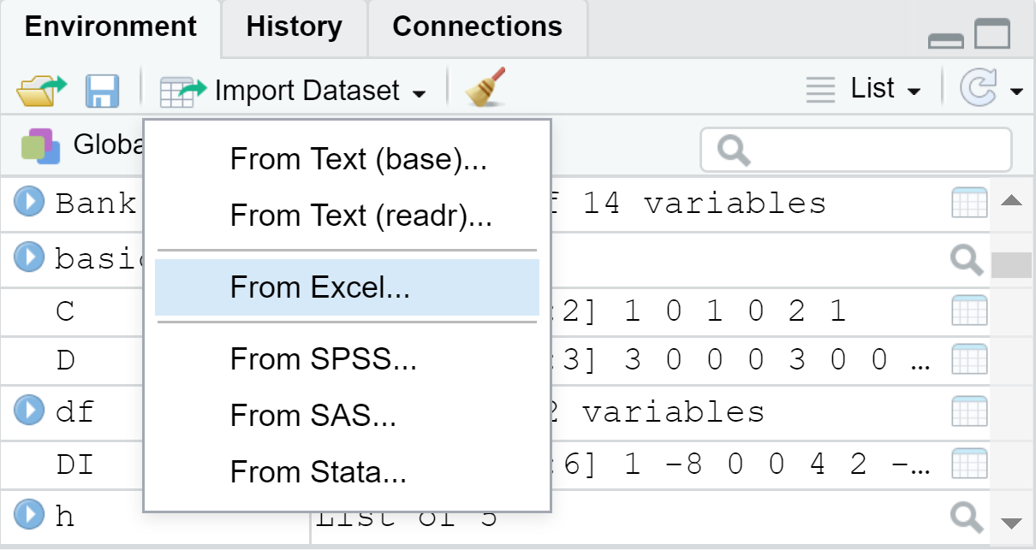
Input and Output in R
Importing a Dataset From Excel
library(readxl)
Data_name = read_excel(“enter the address of the excel file", + sheet = “enter the sheet name")
An easier way: Import Dataset → From Excel
> library(readxl)
> Bank <- read_excel(“address…", + sheet = “mysheet")
> View(Bank)
(Use the posted UniversalBank.xlsx to practice these codes)

Slide 6
Input and Output in R
Exporting a Dataset (Data Frame) in Excel
library(writexl)
write_xlsx(list(Nameofsheet1 = dataforsheet1,
Nameofsheet2 = dataforsheet2,
Nameofsheet3 = dataforsheet3),
"filename.xlsx")
> library(writexl)
> write_xlsx(list(mysheet=df, mysheet2=df),"C:/Users/Vortex/Dropbox/Math course/Bank5.xlsx")

Slide 7
Some Other Statistical Tools
Choose a Random Sample
sample(x, size, replace = FALSE)
x: the vector
size: size of the sample
relace: False/True whether the sample is with replacement or not
In the UniversalBank.xlsx case, after importing the dataset as a new data frame Bank, we can code like this:
> sample(Bank$ID,10)
[1] 1981 3717 2055 1622 868 2893 4634 1231 1202 385

Slide 8
Some Other Statistical Tools
Generating a Random Sequence
sample(x, size, replace = TRUE,Prob)
x: the vector
size: size of the sample
relace: False/True whether the sample is with replacement or not
Prob: a vector of probability weights for obtaining the elements of the vector being sampled.
> sample(c("H","T"),10,replace=TRUE,c(0.5,0.5))
[1] "T" "T" "T" "H" "H" "T" "H" "T" "T" "H"

Slide 9
Some Other Statistical Tools
Tabulating and Creating Contingency Tables
table(x) create a summary table based on different categories in x
Table(x,y) creates a contingency table
x, y: categorical variables
> table(Bank$Family)
1 2 3 4
1472 1296 1010 1222
> table(Bank$Family,Bank$Education)
1 2 3
1 678 326 468
2 657 265 374
3 349 383 278
4 412 429 381

Slide 10
Some Other Statistical Tools
Converting Data to Z-Scores
scale(x)
x: a vector
> v=scale(Bank$Income)
> v[1:5]
[1] -0.5381750 -0.8640230 -1.3636566 0.5697084 -0.6250678

Slide 11
Random Variables

Slide 12


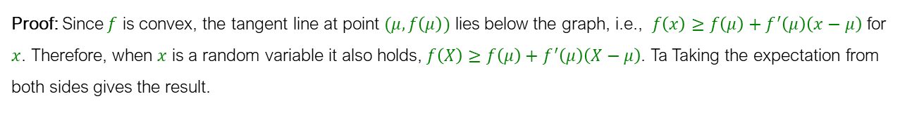

Two Important Properties
Cauchy-Schwartz Inequality: If $X$ and $Y$ are two random variables, then
$${\left(E\left(XY\right)\right)}^{2}≤E(X^{2})E(Y^{2})$$
Proof: For any $z∈\text{ℝ}$, set $Z=zX−Y$. Then, we have
$0≤E\left(Z^{2}\right)=E\left(z^{2}X^{2}−2zXY+Y^{2}\right)=z^{2}E\left(X^{2}\right)−2zE\left(XY\right)+E(Y^{2})$, for all $z∈\text{ℝ}$
The quadratic term ${az}^{2}+bz+c$ is non-negative if and only if $b^{2}−4ac≤0$ and $a>0$. Therefore,
${4\left(E\left(XY\right)\right)}^{2}−4E\left(X^{2}\right)E\left(Y^{2}\right)≤0⇒$ ${\left(E\left(XY\right)\right)}^{2}≤E(X^{2})E(Y^{2})$
Jensen’s Inequality: Let $X$ be a random variable and $f:\text{ℝ}→\text{ℝ}$ be a convex function. Then
$$E\left(f\left(X\right)\right)≥f(E\left(X\right))$$
Proof: Since $f$ is convex, the tangent line at point $(μ,f\left(μ\right))$ lies below the graph, i.e., $f\left(x\right)≥f\left(μ\right)+f^{′}\left(μ\right)\left(x−μ\right)$ for $x$. Therefore, when $x$ is a random variable it also holds, $f\left(X\right)≥f\left(μ\right)+f^{′}\left(μ\right)\left(X−μ\right)$. Ta Taking the expectation from both sides gives the result.

Slide 13

Example
Expectation of a Random Variable
In an on-campus housing lottery with the participation of $N$ students, a bowl contains the names of the $N$ students on sealed envelops. Students, take turns in random order and then each randomly picks one of the envelopes and reads the name written inside (the opened envelops are not put back in the bowl). If the name written inside the envelope matches the student's name s/he will win an on-campus housing. On average how many students will win an on-campus housing?

Slide 14
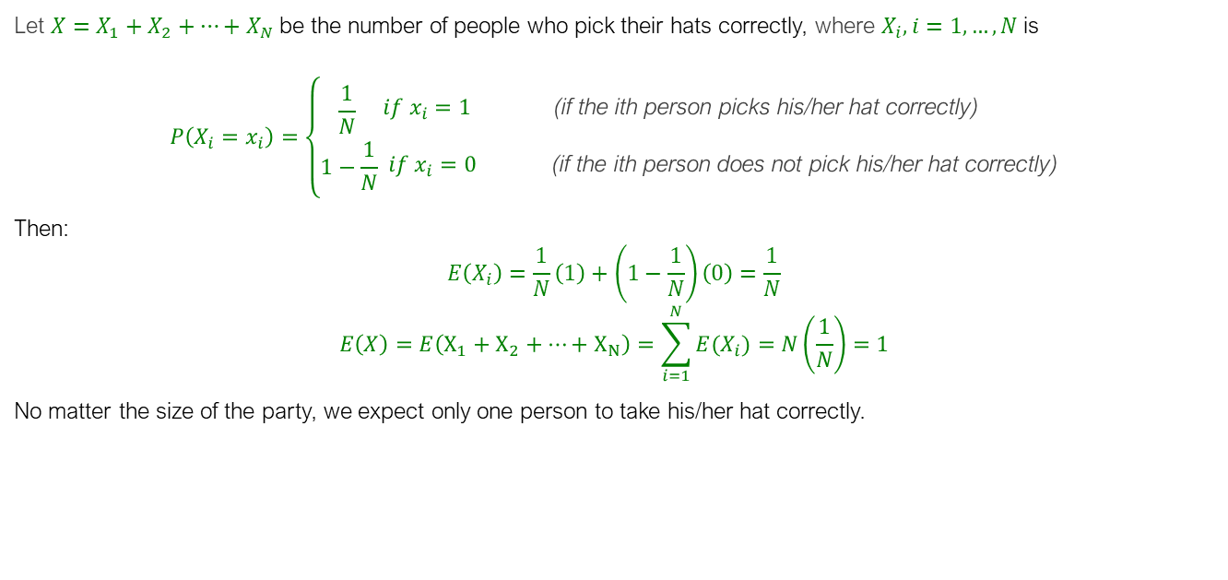
Solution
Let $X=X_{1}+X_{2}+…+X_{N}$ be the number of people who pick their hats correctly, where $X_{i}, i=1,…,N$ is
$$P\left(X_{i}=x_{i}\right)=\left\{\begin{aligned}\frac{1}{N} \\ 1−\frac{1}{N}\end{aligned} \begin{aligned}if x_{i}=1 \\ \\ if x_{i}=0\end{aligned}\begin{aligned} \text{(}\text{if} \text{the} \text{ith} \text{person} \text{picks} \text{his}\text{/}\text{her} \text{hat} \text{correctly}\text{) } \\ \\ \text{(}\text{if} \text{the} \text{ith} \text{person} \text{does} \text{not} \text{pick} \text{his}\text{/}\text{her} \text{hat} \text{correctly}\text{)}\end{aligned}\right.$$
Then:
$$E\left(X_{i}\right)=\frac{1}{N}\left(1\right)+\left(1−\frac{1}{N}\right)\left(0\right)=\frac{1}{N}$$
$$E\left(X\right)=E\left(X_{1}+X_{2}+…+X_{N}\right)=\sum_{i=1}^{N}{E(X_{i})}=N\left(\frac{1}{N}\right)=1$$
No matter the size of the party, we expect only one person to take his/her hat correctly.

Slide 15
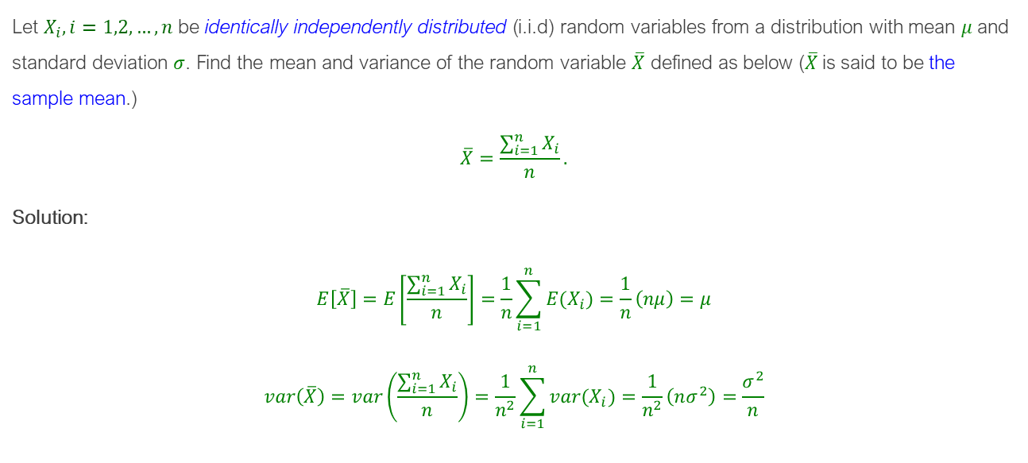
Example
Mean and Variance of Independent Random Variables
Let $X_{i}, i=1,2,…,n$ be identically independently distributed (i.i.d) random variables from a distribution with mean $μ$ and standard deviation $σ$. Find the mean and variance of the random variable $\overline{X}$ defined as below ($\overline{X}$is said to be the sample mean.)
$$\overline{X}=\frac{\sum_{i=1}^{n}{X_{i}}}{n}.$$
Solution:
$$E\left[\overline{X}\right]=E\left[\frac{\sum_{i=1}^{n}{X_{i}}}{n}\right]=\frac{1}{n}\sum_{i=1}^{n}{{E(X}_{i})}=\frac{1}{n}\left(nμ\right)=μ$$
$$var\left(\overline{X}\right)=var\left(\frac{\sum_{i=1}^{n}{X_{i}}}{n}\right)=\frac{1}{n^{2}}\sum_{i=1}^{n}{{var(X}_{i})}=\frac{1}{n^{2}}\left(nσ^{2}\right)=\frac{σ^{2}}{n}$$

Slide 16
Discrete Distributions: Bernoulli Distribution

Slide 17
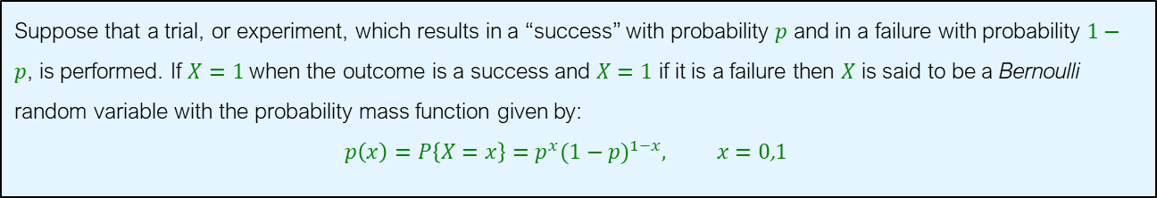
Bernoulli Distribution
Suppose that a trial, or experiment, which results in a “success” with probability $p$ and in a failure with probability $1−p$, is performed. If $X=1$ when the outcome is a success and $X=1$ if it is a failure then $X$ is said to be a Bernoulli random variable with the probability mass function given by:
$$p\left(x\right)=P\left\{X=x\right\}=p^{x}(1−p)^{1−x}, x=0\text{,}1$$

Slide 18

Example
Expectation of a Binomial Random Variable Using Bernoulli
A trial is run for $n$ times independently. Each trial will have two outcomes: success with probability $p$ and failure with probability $1−p$. Suppose $X_{i}=1$ if the $i^{th}$ trial is a success, and it is zero otherwise ($X_{i}$ is called a Bernoulli random variable). Also suppose $X=X_{1}+X_{2}+…+X_{n}$ is a random variable representing the number of successes in $n$ trials ($X_{i}$ is a Binomial random variable). Find $E(X)$.

Slide 19

Solution
It is not difficult to see that for each random variable $X_{i}$defined as:
$$X_{i}=\left\{\begin{aligned}1 \\ 0\end{aligned} \begin{aligned}p \\ 1−p\end{aligned}\right.$$
the expected value of $X_{i}$is:
$$E\left(X_{i}\right)=p,$$
Hence,
$$E\left(X\right)=E\left(\sum_{i=1}^{n}{X_{i}}\right)=\sum_{i=1}^{n}{{E(X}_{i})}=np$$

Slide 20

Example
Variance of a Binomial Random Variable Using Bernoulli
A trial is run for $n$ times independently. Each trial will have two outcomes: success with probability $p$ and failure with probability $1−p$. Suppose $X_{i}=1$ if the $i^{th}$ trial is a success, and it is zero otherwise ($X_{i}$ is called a Bernoulli random variable). Also suppose $X=X_{1}+X_{2}+…+X_{n}$ is a random variable representing the number of successes in $n$ trials ($X_{i}$ is a Binomial random variable). Find $var(X)$.

Slide 21

Solution
It is not difficult to see that for each random variable $X_{i}$defined as:
$$X_{i}=\left\{\begin{aligned}1 \\ 0\end{aligned} \begin{aligned}p \\ 1−p\end{aligned}\right.$$
the expectation and variance are:
$$E\left(X_{i}\right)=p, E\left(X_{i}^{2}\right)=p, var\left(X_{i}\right)=E\left(X_{i}^{2}\right)−E{\left(X_{i}\right)}^{2}=p−p^{2}=p(1−p)$$
Hence,
$$var\left(X\right)=var\left(\sum_{i=1}^{n}{X_{i}}\right)=\sum_{i=1}^{n}{{var(X}_{i})}=np(1−p)$$

Slide 22
Discrete Distributions: Binomial: Additional Details

Slide 23
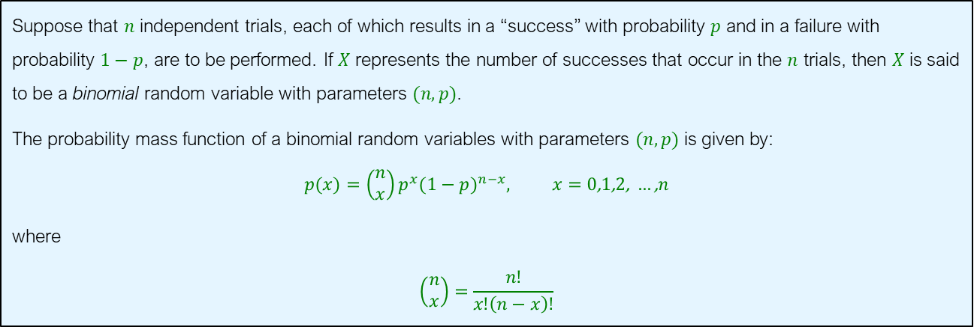

Binomial Distribution
Suppose that $n$ independent trials, each of which results in a “success” with probability $p$ and in a failure with probability $1−p$, are to be performed. If $X$ represents the number of successes that occur in the $n$ trials, then $X$ is said to be a binomial random variable with parameters $(n,p)$.
The probability mass function of a binomial random variables with parameters $(n,p)$ is given by:
$$p(x)=\left(\begin{aligned}&n \\ &x\end{aligned}\right)p^{x}(1−p)^{n−x}, x=0\text{,}1\text{,}2\text{, }…\text{,}n$$
where
$$\left(\begin{aligned}&n \\ &x\end{aligned}\right)=\frac{n\text{!}}{x\text{!}\left(n−x\right)!}$$
Note that the probabilities sum to one, that is,
$$\sum_{x=0}^{∞}{p(x)}=\sum_{x=0}^{n}{\left(\begin{aligned}&n \\ &x\end{aligned}\right)p^{x}(1−p)^{n−x}}={\left(p+\left(1−p\right)\right)}^{n}=1$$

Slide 24
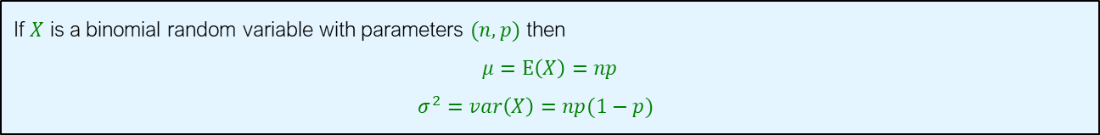
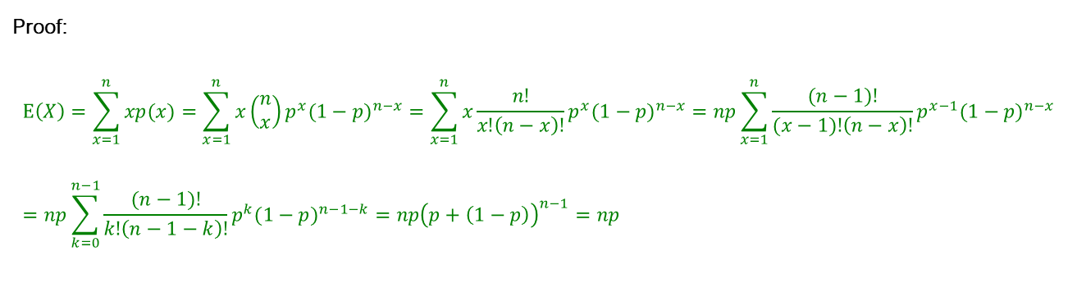
Binomial Mean and Variance
If $X$ is a binomial random variable with parameters $(n,p)$ then
$$μ=E\left(X\right)=np$$
$$σ^{2}=var\left(X\right)=np(1−p)$$
Proof:
$$E\left(X\right)=\sum_{x=1}^{n}{xp(x)}=\sum_{x=1}^{n}{x\left(\begin{aligned}&n \\ &x\end{aligned}\right)p^{x}(1−p)^{n−x}}=\sum_{x=1}^{n}{x\frac{n\text{!}}{x\text{!}\left(n−x\right)!}p^{x}(1−p)^{n−x}}=np\sum_{x=1}^{n}{\frac{(n−1)\text{!}}{(x−1)\text{!}\left(n−x\right)!}p^{x−1}(1−p)^{n−x}}=np\sum_{k=0}^{n−1}{\frac{(n−1)\text{!}}{k\text{!}\left(n−1−k\right)!}p^{k}(1−p)^{n−1−k}}=np{\left(p+\left(1−p\right)\right)}^{n−1}=np$$

Slide 25
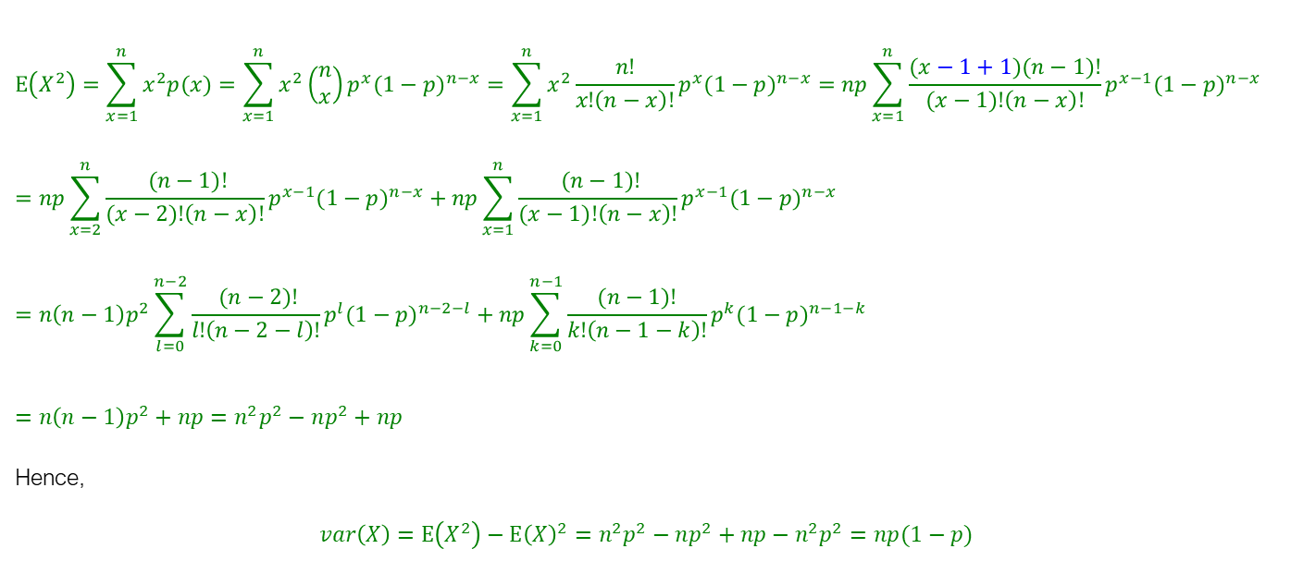
Binomial Mean and Variance
$$E\left(X^{2}\right)=\sum_{x=1}^{n}{x^{2}p(x)}=\sum_{x=1}^{n}{x^{2}\left(\begin{aligned}&n \\ &x\end{aligned}\right)p^{x}(1−p)^{n−x}}=\sum_{x=1}^{n}{x^{2}\frac{n\text{!}}{x\text{!}\left(n−x\right)!}p^{x}(1−p)^{n−x}}=np\sum_{x=1}^{n}{\frac{(x−1+1)(n−1)\text{!}}{(x−1)\text{!}\left(n−x\right)!}p^{x−1}(1−p)^{n−x}}=np\sum_{x=2}^{n}{\frac{ (n−1)\text{!}}{(x−2)\text{!}\left(n−x\right)!}p^{x−1}(1−p)^{n−x}}+np\sum_{x=1}^{n}{\frac{ (n−1)\text{!}}{(x−1)\text{!}\left(n−x\right)!}p^{x−1}(1−p)^{n−x}}=n\left(n−1\right)p^{2}\sum_{l=0}^{n−2}{\frac{ (n−2)\text{!}}{l\text{!}\left(n−2−l\right)!}p^{l}(1−p)^{n−2−l}}+np\sum_{k=0}^{n−1}{\frac{(n−1)\text{!}}{k\text{!}\left(n−1−k\right)!}p^{k}(1−p)^{n−1−k}}$$
$$=n\left(n−1\right)p^{2}+np=n^{2}p^{2}−np^{2}+np$$
Hence,
$$var\left(X\right)=E\left(X^{2}\right)−E{\left(X\right)}^{2}=n^{2}p^{2}−np^{2}+np−n^{2}p^{2}=np(1−p)$$

Slide 26
Discrete Distributions: Poisson Distribution: Additional Details

Slide 27
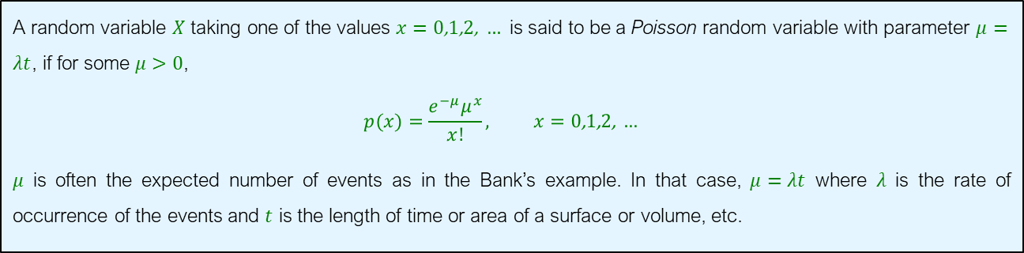

Poisson Distribution
A random variable $X$ taking one of the values $x=0\text{,}1\text{,}2\text{, }…$ is said to be a Poisson random variable with parameter $μ=λt$, if for some $μ>0$,
$$p(x)=\frac{e^{−μ}μ^{x}}{x!}, x=0\text{,}1\text{,}2\text{, }…$$
$μ$ is often the expected number of events as in the Bank’s example. In that case, $μ=λt$ where $λ$ is the rate of occurrence of the events and $t$ is the length of time or area of a surface or volume, etc.
Note that the probabilities sum to one, that is,
$$\sum_{x=0}^{∞}{p(x)}=\sum_{x=0}^{∞}{\frac{e^{−μ}μ^{x}}{x!}}=e^{−μ}\sum_{x=0}^{∞}{\frac{μ^{x}}{x!}}=e^{−μ}e^{μ}=1$$

Slide 28
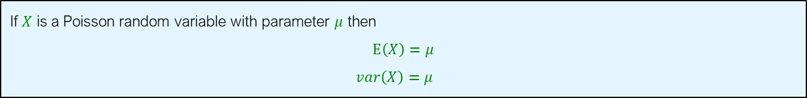
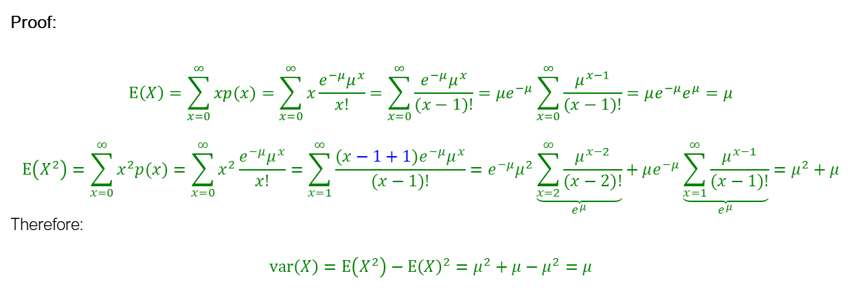
Poisson Mean and Variance
If $X$ is a Poisson random variable with parameter $μ$ then
$$E\left(X\right)=μ$$
$$var\left(X\right)=μ$$
Proof:
$$E\left(X\right)=\sum_{x=0}^{∞}{xp(x)}=\sum_{x=0}^{∞}{x\frac{e^{−μ}μ^{x}}{x!}}=\sum_{x=0}^{∞}{\frac{e^{−μ}μ^{x}}{(x−1)!}}=μe^{−μ}\sum_{x=0}^{∞}{\frac{μ^{x−1}}{(x−1)!}}=μe^{−μ}e^{μ}=μ$$
$$E\left(X^{2}\right)=\sum_{x=0}^{∞}{x^{2}p(x)}=\sum_{x=0}^{∞}{x^{2}\frac{e^{−μ}μ^{x}}{x!}}=\sum_{x=1}^{∞}{\frac{(x−1+1)e^{−μ}μ^{x}}{(x−1)!}}=e^{−μ}μ^{2}\underset{e^{μ}}{\underbrace{\sum_{x=2}^{∞}{\frac{μ^{x−2}}{(x−2)!}}}}+μe^{−μ}\underset{e^{μ}}{\underbrace{\sum_{x=1}^{∞}{\frac{μ^{x−1}}{(x−1)!}}}}=μ^{2}+μ$$
Therefore:
$$var\left(X\right)=E\left(X^{2}\right)−E{\left(X\right)}^{2}=μ^{2}+μ−μ^{2}=μ$$

Slide 29
Discrete Distributions: Geometric Distribution

Slide 30
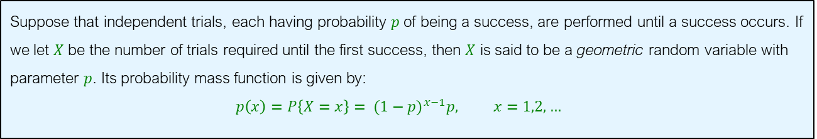
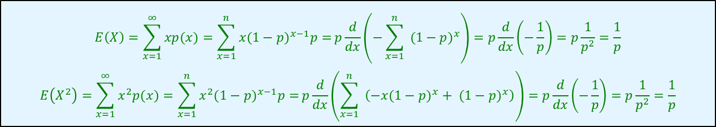

Geometric Distribution
Suppose that independent trials, each having probability $p$ of being a success, are performed until a success occurs. If we let $X$ be the number of trials required until the first success, then $X$ is said to be a geometric random variable with parameter $p$. Its probability mass function is given by:
$$p\left(x\right)=P\left\{X=x\right\}= (1−p)^{x−1}p, x=1,2,…$$
Note that the probabilities sum to one, that is,
$$\sum_{x=1}^{∞}{p(x)}=\sum_{x=1}^{n}{(1−p)^{x−1}p}=\frac{p}{1−(1−p)}=1$$
$$E\left(X\right)=\sum_{x=1}^{∞}{xp(x)}=\sum_{x=1}^{n}{x(1−p)^{x−1}p=}p\frac{d}{dx}\left(−\sum_{x=1}^{n}{ (1−p)^{x}}\right)=p\frac{d}{dx}\left(−\frac{1}{p}\right)=p\frac{1}{p^{2}}=\frac{1}{p}$$
$$E\left(X^{2}\right)=\sum_{x=1}^{∞}{x^{2}p(x)}=\sum_{x=1}^{n}{x^{2}(1−p)^{x−1}p=}p\frac{d}{dx}\left(\sum_{x=1}^{n}{ \left(−x(1−p)^{x}+ (1−p)^{x}\right)}\right)=p\frac{d}{dx}\left(−\frac{1}{p}\right)=p\frac{1}{p^{2}}=\frac{1}{p}$$

Slide 31

Example
If a fair coin is successively flipped, what is the probability that a head first appears on the fifth trial?
Solution:
$$p\left(5\right)=P\left\{X=5\right\}= (1−p)^{5−1}p={\left(\frac{1}{2}\right)}^{5}=\frac{1}{32}$$

Slide 32
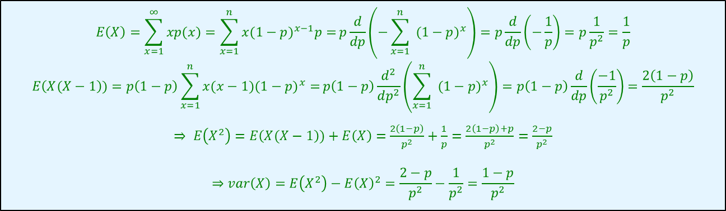
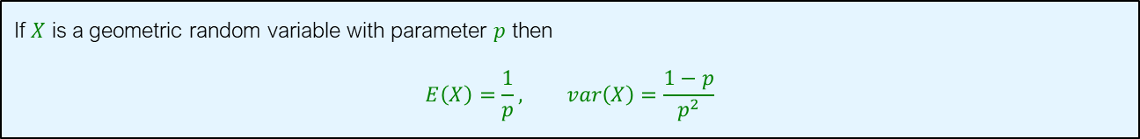
Geometric Distribution
If $X$ is a geometric random variable with parameter $p$ then
$$E\left(X\right)=\frac{1}{p}, var\left(X\right)=\frac{1−p}{p^{2}}$$
$$E\left(X\right)=\sum_{x=1}^{∞}{xp(x)}=\sum_{x=1}^{n}{x(1−p)^{x−1}p=}p\frac{d}{dp}\left(−\sum_{x=1}^{n}{ (1−p)^{x}}\right)=p\frac{d}{dp}\left(−\frac{1}{p}\right)=p\frac{1}{p^{2}}=\frac{1}{p}$$
$$E\left(X(X−1\right))=p\left(1−p\right)\sum_{x=1}^{n}{x(x−1)(1−p)^{x}=}p\left(1−p\right)\frac{d^{2}}{dp^{2}}\left(\sum_{x=1}^{n}{ (1−p)^{x}}\right)=p\left(1−p\right)\frac{d}{dp}\left(\frac{−1}{p^{2}}\right)=\frac{2\left(1−p\right)}{p^{2}}$$
$⇒ E\left(X^{2}\right)=E\left(X(X−1\right))+E\left(X\right)=$ $\frac{2\left(1−p\right)}{p^{2}}+\frac{1}{p}=\frac{2\left(1−p\right)+p}{p^{2}}=\frac{2−p}{p^{2}}$
$$⇒var\left(X\right)=E\left(X^{2}\right)−E{\left(X\right)}^{2}=\frac{2−p}{p^{2}}−\frac{1}{p^{2}}=\frac{1−p}{p^{2}}$$

Slide 33

Example
Suppose that a powerplant electricity generation is handled by a number of independent control systems that operate in parallel to one another. Any of the control systems can fail, during the electricity generation process, with probability $1−p$ independently from other control systems. Suppose that the powerplant can generate electricity successfully during a day if at least 50 percent of its control systems remain operative. For what values of $p$ having a powerplant with 4 parallel control systems is more preferable to a powerplant with two control system?

Slide 34
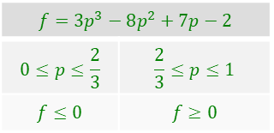
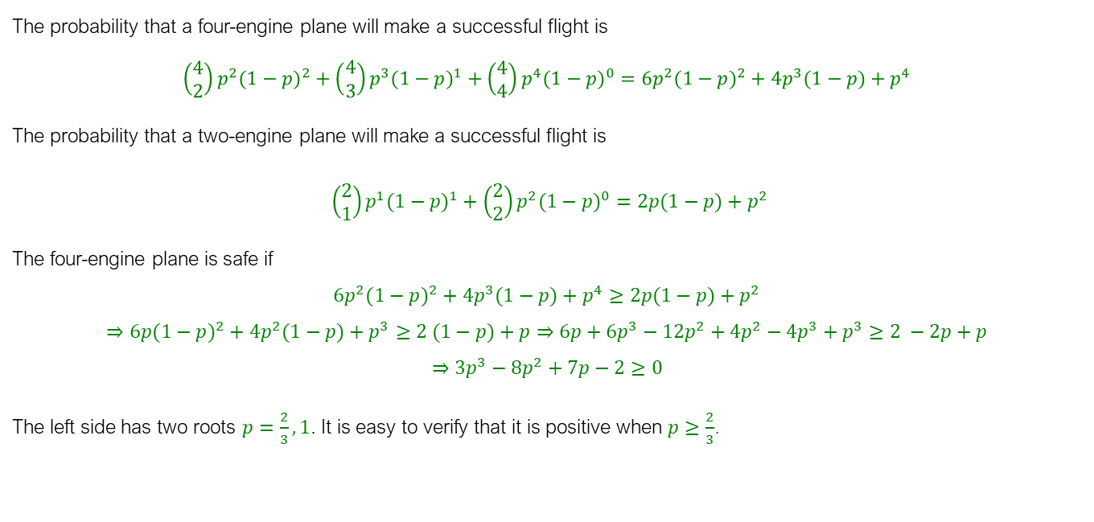
Solution
The probability that a four-engine plane will make a successful flight is
$$\left(\begin{aligned}&4 \\ &2\end{aligned}\right)p^{2}(1−p)^{2}+\left(\begin{aligned}&4 \\ &3\end{aligned}\right)p^{3}(1−p)^{1}+\left(\begin{aligned}&4 \\ &4\end{aligned}\right)p^{4}(1−p)^{0}=6p^{2}(1−p)^{2}+4p^{3}(1−p)+p^{4}$$
The probability that a two-engine plane will make a successful flight is
$\left(\begin{aligned}&2 \\ &1\end{aligned}\right)p^{1}(1−p)^{1}+\left(\begin{aligned}&2 \\ &2\end{aligned}\right)p^{2}(1−p)^{0}=2p(1−p)+p^{2}$
The four-engine plane is safe if
$$6p^{2}(1−p)^{2}+4p^{3}(1−p)+p^{4}≥2p(1−p)+p^{2}$$
$$⇒6p(1−p)^{2}+4p^{2}(1−p)+p^{3}≥2 (1−p)+p⇒6p+6p^{3}−12p^{2}+4p^{2}−4p^{3}+p^{3}≥2 −2p+p$$
$$⇒3p^{3}−8p^{2}+7p−2≥0$$
The left side has two roots $p=\frac{2}{3},1$. It is easy to verify that it is positive when $p≥\frac{2}{3}$.
$$f=3p^{3}−8p^{2}+7p−2$$
$$0≤p≤\frac{2}{3}$$ | $$\frac{2}{3}≤p≤1$$
$$f≤0$$ | $$f≥0$$

Slide 35
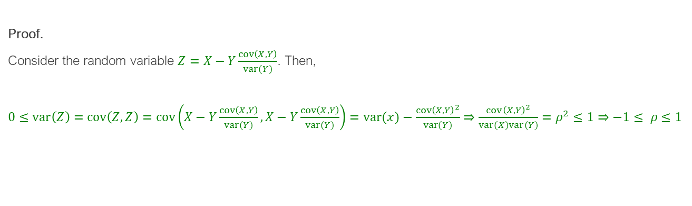
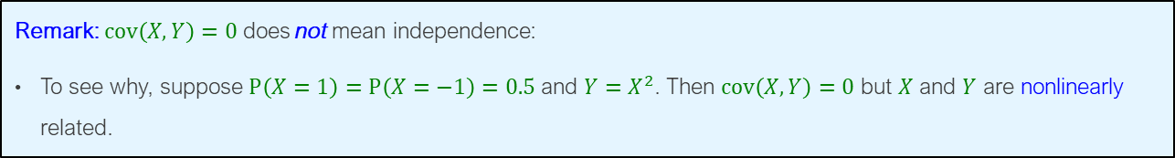
Correlation Property
$$−1≤ρ=\frac{Cov\left(X,Y\right)}{σ_{X}σ_{Y}}≤1$$
Proof.
Consider the random variable $Z=X−Y\frac{cov\left(X,Y\right)}{var(Y)}$. Then,
$0≤var\left(Z\right)=cov\left(Z,Z\right)=cov\left(X−Y\frac{cov\left(X,Y\right)}{var(Y)},X−Y\frac{cov\left(X,Y\right)}{var(Y)}\right)=var(x)−\frac{cov{\left(X,Y\right)}^{2}}{var(Y)}⇒$ $\frac{cov{\left(X,Y\right)}^{2}}{var(X)var(Y)}=ρ^{2}≤1⇒−1≤ ρ≤1$
Remark: $cov\left(X,Y\right)=0$ does not mean independence:
To see why, suppose $P\left(X=1\right)=P\left(X=−1\right)=0.5$ and $Y=X^{2}$. Then $cov\left(X,Y\right)=0$ but $X$ and $Y$ are nonlinearly related.

